Slide 1

Mapping ER model to relational schema
Database Management System | Database Design and Advanced Normalization
Course: Database Management System | Chapter: Database Design and Advanced Normalization | Program: Bachelor of Engineering
DISCOVER · LEARN · EMPOWER
Notes:
Welcome to today's lecture on mapping ER models to relational schemas. This is a critical step in the database design process where we translate our conceptual designs into implementable structures. We will focus on the rules that ensure data integrity while maintaining the relationships defined in our ER diagrams. Let us begin by understanding the specific outcomes we aim to achieve in this session.

Slide 2
Course Outcomes
SLIDE 2 / 14
Course Outcome
CO | BT LEVEL | DESCRIPTION
CO1 | BT2 | Explain database architecture, relational model concepts and formal query language foundations including relational algebra and relational calculus.
CO2 | BT3 | Apply relational algebra, relational calculus and SQL constructs to formulate correct and efficient database queries.
CO3 | BT4 | Analyze functional dependencies and design normalized relational schemas up to 5NF ensuring lossless join and dependency preservation.
CO4 | BT4 | Analyze transaction schedules and concurrency control mechanisms to determine serializability, recoverability and correctness.
CO5 | BT5 | Evaluate storage structures, indexing strategies and query optimization techniques for performance, scalability and reliability.
Chandigarh University
2 / 14
Notes:
Today's lecture directly addresses two key course outcomes. First, we will apply relational algebra concepts to ensure our mapped schemas support efficient queries. Second, we will analyze functional dependencies to design normalized schemas that guarantee lossless joins and dependency preservation. These skills are essential for creating robust database systems.

Slide 3
Learning Objectives
SLIDE 3 / 14
Learning Outcomes
1
Analyze the fundamental rules for mapping regular entity sets to relations.
2
Evaluate strategies for mapping weak entity sets and their identifying relationships.
3
Apply transformation rules for binary and n-ary relationship sets in schemas.
4
Synthesize a complete relational schema from a complex ER diagram example.
5
Critique common pitfalls in mapping many-to-many relationships to tables.
Chandigarh University
3 / 14
Notes:
By the end of this session, you will be able to analyze and apply specific rules for different entity types. We will evaluate how weak entities and complex relationships are handled differently than regular entities. You will synthesize a complete schema from a complex example, ensuring you understand the 'why' behind each table creation. Finally, we will critique common mistakes to avoid in your own designs.

Slide 4
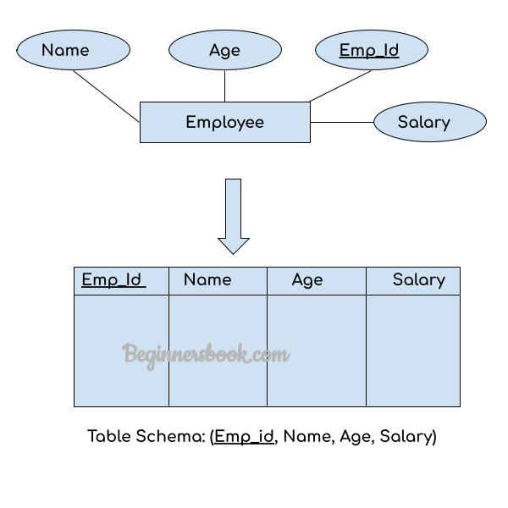
Lecture
SLIDE 4 / 14
Mapping Regular Entity Sets
1
Each regular entity set becomes a separate relation with its own primary key.
2
Attributes of the entity set become columns in the corresponding relation.
3
The primary key of the entity set becomes the primary key of the relation.
4
Composite attributes are flattened into individual columns in the new relation.
5
Multivalued attributes require a separate relation linked by the primary key.
6
Derived attributes are typically omitted unless they are frequently queried.
DBMS – ER Diagram to Table Conversion
Chandigarh University
4 / 14
Notes:
Let's start with the simplest case: regular entity sets. Every regular entity set maps directly to a table. For example, the 'Student' entity becomes a 'Student' table where 'Student_ID' is the primary key. Composite attributes like 'Address' are flattened into 'Street', 'City', and 'Zip'. Multivalued attributes, such as 'Phone_Numbers', require a separate table to maintain first normal form.

Slide 5
Lecture
SLIDE 5 / 14
Mapping Weak Entity Sets
1
Weak entities depend on a strong entity for their existence and identification.
2
The relation for a weak entity includes the primary key of the strong entity.
3
The primary key of the weak relation is a combination of its partial key and owner key.
4
The relationship identifying the weak entity is implicit in the foreign key constraint.
5
Deleting the strong entity automatically deletes the associated weak entity records.
6
The foreign key must be part of the primary key of the weak relation.
Chandigarh University
5 / 14
Notes:
Weak entities are unique because they cannot exist without a strong entity. Consider 'Order_Line' which depends on 'Order'. The 'Order_Line' table must include 'Order_ID' as a foreign key. The primary key of 'Order_Line' is a composite of 'Order_ID' and 'Line_Number'. This ensures that a line item cannot exist without a valid order, enforcing the dependency.

Slide 6
Mapping Binary 1
SLIDE 6 / 14
1 Relationships
1
Map the relationship by adding the primary key of one entity to the other.
2
Choose the entity with the optional participation to receive the foreign key.
3
If both sides are mandatory, choose either side arbitrarily for the foreign key.
4
The foreign key constraint enforces the one-to-one cardinality requirement.
5
Merging two tables into one is an alternative if the relationship is mandatory.
6
This approach avoids creating a separate relation for the relationship itself.
Chandigarh University
6 / 14
Notes:
For one-to-one relationships, we typically merge the tables. We add the primary key of one entity as a foreign key in the other. If participation is optional, the foreign key goes into the optional side. For example, if an 'Employee' has a 'Manager', the 'Employee' table gets a 'Manager_ID'. This avoids a separate 'Manages' table and simplifies queries.

Slide 7
Mapping Binary 1
SLIDE 7 / 14
N Relationships
1
Map the relationship by adding the primary key of the 'one' side to the 'many' side.
2
The foreign key is placed in the relation corresponding to the 'many' entity.
3
The primary key of the 'many' entity remains unchanged in the new relation.
4
This creates a direct link without requiring a separate relationship table.
5
The foreign key constraint ensures referential integrity between the two entities.
6
This is the most common mapping strategy for one-to-many associations.
Chandigarh University
7 / 14
Notes:
In a one-to-many relationship, the foreign key goes into the 'many' side. For instance, one 'Department' has many 'Employees'. We add 'Dept_ID' to the 'Employee' table. This creates a direct link where each employee record points to their department. This is efficient and avoids unnecessary joins for simple lookups.

Slide 8
Mapping Binary M
SLIDE 8 / 14
N Relationships
1
M:N relationships cannot be represented by a simple foreign key in either table.
2
A separate relation is created with the primary keys of both entities.
3
The primary key of the new relation is the combination of both foreign keys.
4
Attributes of the relationship become columns in this new relationship table.
5
This ensures that each pair of entities is uniquely identified in the schema.
6
The foreign keys reference the primary keys of the participating entity tables.
Chandigarh University
8 / 14
Notes:
Many-to-many relationships require a separate table. For 'Student' and 'Course', we create an 'Enrollment' table. This table contains 'Student_ID' and 'Course_ID' as foreign keys. Together, they form the composite primary key. Any attributes of the relationship, like 'Grade' or 'Enrollment_Date', are added as columns here. This structure prevents data redundancy and maintains integrity.

Slide 9
Lecture
SLIDE 9 / 14
Mapping N-ary Relationships
1
N-ary relationships involve three or more entity sets participating in a relationship.
2
A separate relation is created for the relationship with all participating keys.
3
The primary key is a combination of the primary keys of all entities.
4
Attributes of the relationship are included as columns in the new relation.
5
This approach generalizes the M:N mapping strategy to higher cardinalities.
6
Referential integrity is maintained through foreign keys to all participating entities.
Chandigarh University
9 / 14
Notes:
When three or more entities are involved, we treat it similarly to M:N. We create a new table for the relationship. For a 'Teaching' relationship involving 'Student', 'Course', and 'Instructor', the new table has keys from all three. The primary key is the combination of these three IDs. This ensures that a specific student is taught a specific course by a specific instructor.

Slide 10
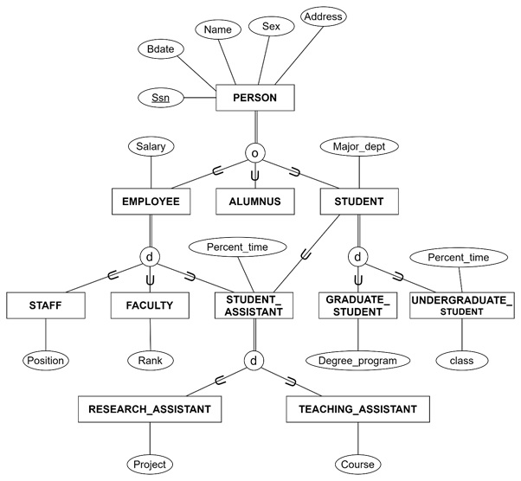
Lecture
SLIDE 10 / 14
Mapping ISA Hierarchies
1
ISA hierarchies represent generalization and specialization among entity sets.
2
Option 1: Map each entity set to a separate relation with inheritance.
3
Option 2: Map the superclass and subclass into a single combined relation.
4
Option 3: Map the superclass to a relation and subclasses to separate tables.
5
The choice depends on query patterns and storage efficiency requirements.
6
Option 1 preserves all attributes but may lead to sparse tables.
Source: www.tutorialspoint.com
Chandigarh University
10 / 14
Notes:
ISA hierarchies can be mapped in three ways. Option 1 creates a table for each level, preserving all attributes but potentially creating sparse tables. Option 2 merges everything into one large table, which is simple but may have many nulls. Option 3 creates a superclass table and separate subclass tables. The best choice depends on how you plan to query the data.

Slide 11
Worked Example
SLIDE 11 / 14
University Schema
1
Entity 'Student' maps to table Student(SID, Name, Major, GPA).
2
Entity 'Course' maps to table Course(CID, Title, Credits).
3
Relationship 'Enrolls' (M:N) maps to table Enrollment(SID, CID, Grade).
4
Primary key of Enrollment is (SID, CID) to ensure unique enrollment.
5
Foreign keys reference Student(SID) and Course(CID) for integrity.
6
This schema supports queries for student grades and course enrollments.
Chandigarh University
11 / 14
Notes:
Let's apply this to a university example. 'Student' becomes a table with 'SID' as the key. 'Course' becomes a table with 'CID'. The 'Enrolls' relationship becomes a table with 'SID' and 'CID' as a composite key. This allows us to track which student is enrolled in which course and their grade. This structure is efficient for querying student performance.

Slide 12
Lecture
SLIDE 12 / 14
Common Pitfalls in Mapping
1
Failing to create a separate table for M:N relationships causes redundancy.
2
Using a single foreign key for M:N relationships violates normalization rules.
3
Ignoring weak entity dependencies leads to orphaned records in the database.
4
Incorrectly handling ISA hierarchies can result in loss of specific attributes.
5
Over-normalizing can lead to excessive joins and performance degradation.
6
Neglecting derived attributes may require complex queries later.
Chandigarh University
12 / 14
Notes:
There are common pitfalls to avoid. A frequent mistake is trying to map M:N relationships with a single foreign key, which creates redundancy. Another is ignoring weak entity dependencies, leading to orphaned records. Incorrect handling of ISA hierarchies can also cause data loss. Always ensure your mapping preserves the relationships and constraints defined in the ER model.

Slide 13
Lecture
SLIDE 13 / 14
Key Takeaways
1
Regular entities map directly to tables with flattened attributes.
2
Weak entities require the owner's primary key in their own table.
3
M:N relationships always require a separate relation with composite keys.
4
ISA hierarchies offer multiple mapping strategies based on query needs.
5
Proper mapping ensures lossless joins and dependency preservation in schemas.
Chandigarh University
13 / 14
Notes:
To summarize, regular entities map directly to tables. Weak entities need the owner's key. Many-to-many relationships always need a separate table. ISA hierarchies offer flexibility based on your needs. Finally, proper mapping ensures your database is normalized and efficient. These principles are the foundation of good database design.

Slide 14
Lecture
SLIDE 14 / 14
References
1
Fundamentals of Database Systems — Ramez Elmasri & Shamkant B. Navathe
2
Database System Concepts — Silberschatz, Korth & Sudarshan
3
Database Management Systems — Raghu Ramakrishnan & Johannes Gehrke
4
Oracle/MySQL Documentation — Oracle
Chandigarh University
14 / 14
Notes:
For further reading, I recommend the textbooks by Elmasri & Navathe, Silberschatz et al., and Ramakrishnan & Gehrke. These resources provide deep insights into database design and normalization. The Oracle and MySQL documentation are also excellent for practical implementation details. Thank you for your attention, and I am available for any questions.

